Slide 1
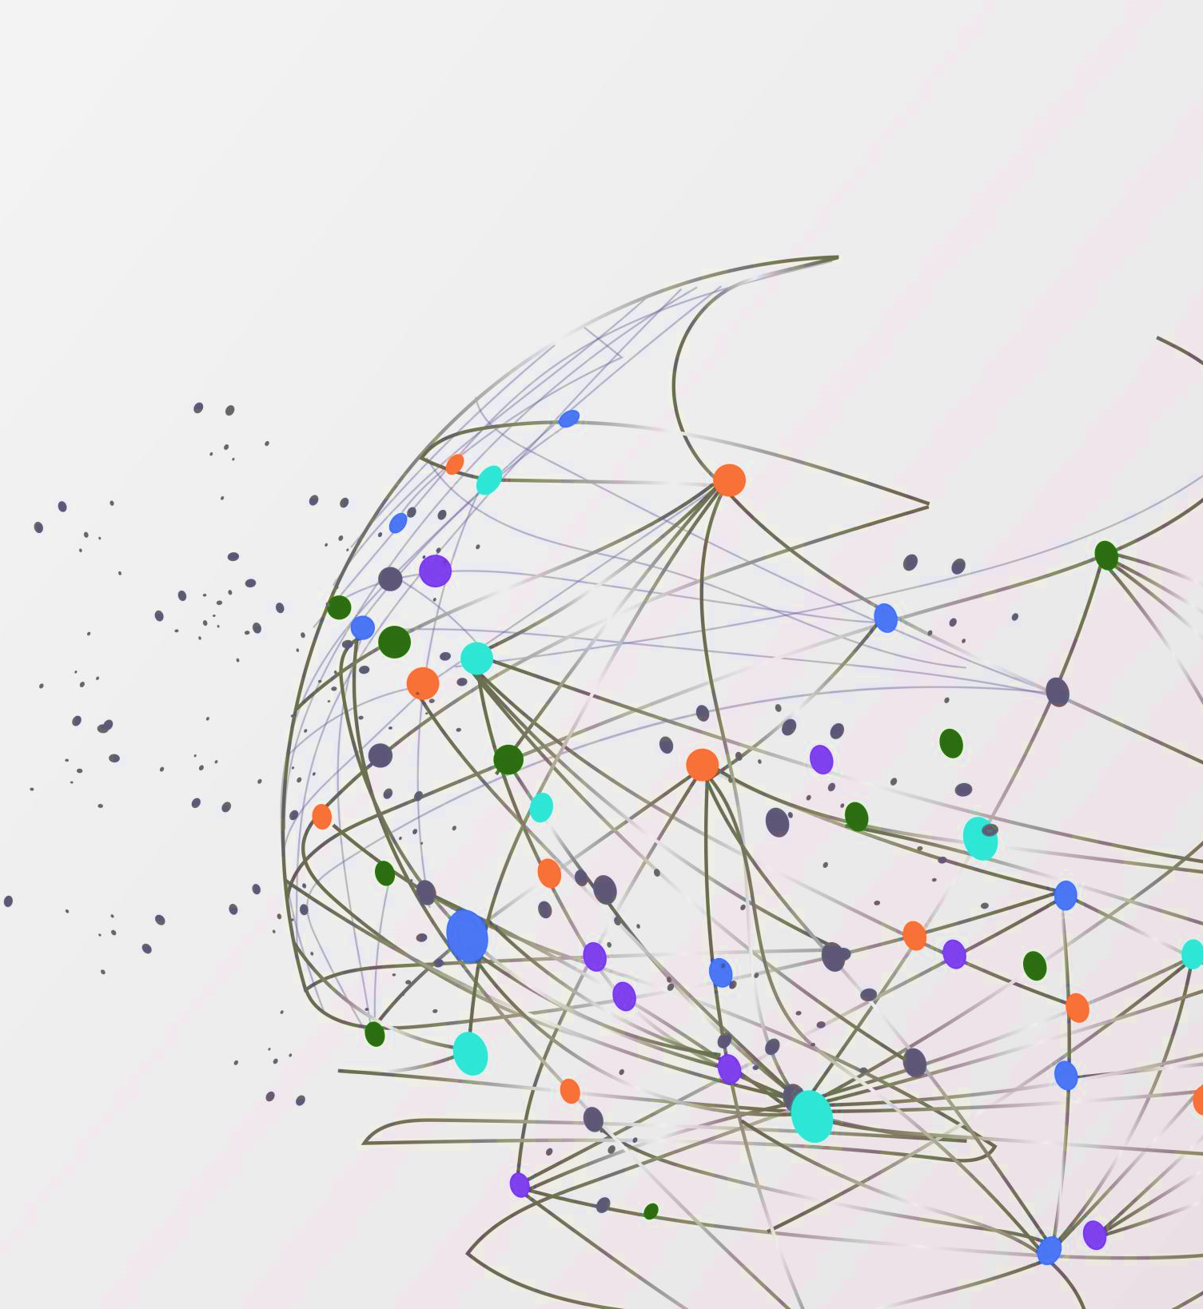
Welcome! 2024 – 2025 CeHS Spiritline Season
Parent / Athlete Informational Meeting

Slide 3
LEADERS OF THE PACK

Slide 4
LEADERS OF THE PACK
Carlos Gonzales
James marinaro
The 2024-2025 season will be Coach Gonzales’s 10th season with Centennial. This will mark Coach G 22nd Year Coaching!!! He is a current High School Math Teacher and graduated from Grand Canyon University with his Masters in Business Administration in Financing and has a Second Masters in Education Leadership. He is AACCA, NFHS, CPR, and First Aid certified and is currently a Varsity Spirit Camp Administrator in his 6th year.
The 2024-2025 season will be Coach Marinaro’s 10th season with Centennial. This will mark Coach M 20th year coaching. He is a current High School Dance Teacher, Professional Dancer / Choreographer for Wight Noise Dance, and has completed his Masters in Secondary Education and Masters in Educational Leadership from Grand Canyon University. He is AACCA, NFHS, CPR, and First Aid certified and is currently a Varsity Spirit Camp Administrator in his 6th year.

Slide 5
LEADERS OF THE PACK
Brittany Marshall
Cammy ebel
The 2024-2025 season will be Coach Marshall’s 3rd season with Centennial and 12th season coaching cheer. She started out coaching middle school cheer and has been coaching high school for the past 6 years. She is a current high school math teacher and graduated from Ottawa University. She is AACCA, NFHS, and CPR/First Aid certified. Coach Marshall has admired the CeHS Spiritline program for many years and is beyond thrilled to be a part of it.
The 2024-2025 season will be Coach Ebel’s 2nd season coaching with Centennial High School. Coach Ebel comes from Chico, California where she coached their Dance Team for the past (3) years. Coach Ebel is exciting to be joining the Coyote Family. Cammy has been professionally dancing and choreographing since she graduated high school and is currently on staff at Gotta Dance Company in Peoria, Az!

Slide 6
Tryout / clinic dates
Cheer/Pom Clinics (Incoming Freshmen Should Attend All Days)
Wednesday May 1st @ 2:45pm – 5:30pm
Thursday May 2nd @ 2:45pm – 5:30pm
Friday May 3rd @ 2:45pm – 5:30pm
Final Tryouts (No Incoming Freshmen)***
Saturday May 4th 8:00 am
*** Per AIA, no incoming Freshman will be giving a number or allowed at Final Try Out Day due to “Incoming Freshman Rule / Liability***

Slide 7
Prep-Clinics
Working on details and dates.
Will be posting soon
Benefits of attending
Work with coaches
Coaches get to see skill levels
Meet other girls who are trying out/attending clinics

Slide 8
“What should I wear to clinics?”
cheer
pom
Form Fitting T-Shirt or Tank Top (No mid-drift showing)
Soffee Shorts /Athletic Shorts / Nike Pros
Spanks (Short Spandex) to wear underneath shorts
Lightweight tennis shoes or cheer shoes and “no show” socks
Please note we will be taking a headshot photo of you on Day 1.
All returning members please do NOT wear any Spiritline clothing from past seasons.
Form Fitting T-Shirt or Tank Top (No mid-drift showing)
Soffee Shorts /Athletic Shorts / Nike Pros
Spanks (Short Spandex) to wear underneath shorts.
Jazz Shoes / Pirouettes Shoes (No Bare Feet or Socks)
Hair must be low tight bun.
Please note we will be taking a headshot photo of you on Day 1.
All returning members please do NOT wear any Spiritline clothing from past seasons.

Slide 9
“What should I wear for final try outs?”
Solid Black T-Shirt / Tank Top (No Mid-Drift Showing)
Red / Navy / White Soffee Shorts or Solid Black Nike Pros
Spank Shorts (Short Spandex) to wear underneath shorts.
White no-show socks (Cheer)
Tennis shoes/Cheer shoes (Cheer)
Jazz Shoes / Pirouettes (Pom)
Hair pulled back into high pony (Cheer)
Hair low tight bun (Pom)
Do not have hair hanging in / on your face.
All returning members please do NOT wear any Spiritline clothing from past seasons.

Slide 10
Financial commitment
All Spiritline members will be given several opportunities to fundraise money for various items throughout the year and are expected to take advantage of these opportunities. If team members do not raise enough to cover the individual cost, then they will be asked to pay out of pocket. Any team member that needs financial assistance or in a hardship should talk to coaches. Tax Credit donations are great for raising funds to be used. It’s never too early to ask family and friends to donate. Here is a breakdown of the full season. Remember these payments are broken up over time and not all due at once. We will apply fundraisers to each kid’s account as we process and complete them.
*** All the cost listed on the next few pages are without any Fundraising. We will do as many fundraisers as possible to get the cost down. National’s cost are on the high end as there are (2) Nationals listed. This is also based on number of members attending***

Slide 11
Financial commitment
New Varsity Cheer or Pom Members

Slide 12
Financial commitment
Returning Varsity Cheer or Pom Members

Slide 13
Financial commitment
New JV Cheer or Pom Members

Slide 14
Financial commitment
Returning JV Cheer or Pom Members

Slide 15
Participation Fee
https://az-peoria-lite.intouchreceipting.com/
PUSD Rule and NEEDS to be a Tax Credit Participation Fee is Due in August for $100. This will go to the bookstore NOT to coaches or Spiritlifters Booster.

Slide 16
Teams at centennial hs
Varsity game team
Varsity competition game day / show cheer
All candidates selected for the varsity team will be freshmen, sophomores, juniors, and seniors during the school year. Members will be expected to make their commitment to their team a priority and will not be able to participate on any other CeHS team until the season is over. Varsity Sideline will cheer at all home and away football games, home basketball games, school assemblies and various school and community functions. They will have one practice per week over summer to prepare for games and work on skills.
Will attend local and national competitions selected by the coaches. Whether competition teams attend nationals are determined on a yearly basis. It is never a guarantee. The team needs to earn the privilege to compete, both with the various cheer organizations and with the coaches and school administration. You MUST have a standing backhand spring and running back handspring to be considered for this team. If you do make the competition team, please understand you will be required to attend team tumbling classes on Wednesday’s from 1pm-2:30pm at AZ Element Elite starting in August (Additional fees apply). We also have a mandatory camp/choreography class that you must be present for this team and also comes with an additional cost. It is best to start attending AZ Element now and do some drop-in class so you are familiar with the coaching staff.

Slide 17
Teams at centennial hs
Varsity / JV pom Game team
Varsity / JV pom / jazz competition
All candidates selected for the varsity pom team will be freshmen, sophomores, juniors, and seniors during the next school year. The pom team will attend all football games both home and away with Cheer and perform at football games, basketball games, school assemblies, and various school and community functions. Varsity Pom Sideline will practice one a week during the summer to prepare for all games and events.
This team will consist of experienced dancers with a high level of technique and training. All candidates selected on this team will be freshmen, sophomores, and juniors during the next school year. Per AIA rules, seniors cannot be on the JV teams, regardless of the sport. You MUST have a quad turn, a la seconde turns, as well as strong flexibility and knowledge of dance technique as well as an aerial.

Slide 18
Teams at centennial hs
Junior varsity Game Team
Junior varsity Competition team
All candidates selected on this team will be freshmen, sophomores, and juniors during the next school year. Per AIA rules, seniors cannot be on the JV teams, regardless of the sport. The purpose of JV will be to promote school spirit, cheer at home games for football and basketball games and to focus on building the fundamentals skills of cheerleading. JV will complete at 2 in state competitions In Feb 2024)
Will attend local and national competitions selected by the coaches. Whether competition teams attend nationals are determined on a yearly basis. It is never a guarantee. The team needs to earn the privilege to compete, both with the various cheer organizations and with the coaches and school administration.

Slide 19
Important dates to keep!
In order to compete at USA / UCA / NHSCC / NDTC Nationals we must have each athlete get credentials. We only have summer camps to get this covered, meaning if you plan to try to be part of a comp team including Game Day Team, you MUST attend Cheer/ pom camps and Choreography dates. Please keep these dates open and work around the following for summer/vacations.
Pom Camp – July 14th – 17th at the Az Grand Resort (Phoenix, Az)
Cheer Camp – July 21st – 24th at the Az Grand Resort (Phoenix, Az)
* * Dates are Tentative till we get Final Confirmation on Numbers / Choreographers * * *
August 16th and 17th (Game Day Team Choreography, Show Cheer, Pom, Jazz)

Slide 20
Non-negotiable!
Last season we had a large number of athletes that were doing a skill, and the nationals felt they could not do it so chose not to. This will not be accepted this season. If you are given a skill and cannot do it, then we will need to remove you from that team and place you where we see fit for the season.

Slide 21
Anticipated practice schedules
Summer days and hours
Regular season (during school)
Tuesday
Cheer 8am – 11am
Pom 8am – 11am
Wednesday
Cheer 8am – 11am
Pom 8am – 11am
Thursday
Cheer 8am – 11am
Pom 8am – 11am
Monday
Cheer 2:45pm – 5:30pm
Pom 2:45pm – 5:30pm
Tuesday
Cheer 2:45pm – 5:30pm
AZ Element 6pm – 7pm
Pom 2:45pm – 5:30pm
Wednesday
Cheer 2:45pm – 5:30pm
Pom 2:45pm – 5:30pm
Thursday
Cheer 2:45pm – 5:30pm
Pom 2:45pm – 5:30pm

Slide 22
Booster Info
Elected positions (Please use the link at the bottom of this page if you are interested)
President
Vice President
Treasure
Co-Treasure
Secretary
At-Large positions open all season
https://forms.gle/3h5iX9HWaqakyRCK9

Slide 23
First official Meeting of the 24-25 season
Wednesday May 8th 6pm
Also, when first payment due of $350
June 5th Payment #2 Due (50% of balance)
June 26th Payment #3 Due (Remaining Balance)

Slide 24
Contact information
Coach | Email
Coach Gonzales (Varsity Cheer ) | cargonzales@pusd11.net
Coach Marinaro (Varsity / JV Pom) | jmarinaro@pusd11.net
Coach Marshall (JV Cheer) | Brmarshall@pusd11.net
Coach Ebel (Varsity / JV Pom) | cammy.ebel@gmail.com

